Slide 1



Unsupervised Learning - Dimensional Reduction
Have too much variables? We can reduce them down.
Special Crafted by
Akbar Maulana

Slide 2



Trainer Bio
Experience :
Data Scientist at Jabar Digital Service
Data Science Tutor at Shift Academy
Business Intelligence Analyst at Jabar Digital Service
Owner and Consultant at Barz Data Consultant
Data Scientist at IYKRA
Data Analyst at BAPPEDA Sukoharjo
Data Analyst at PT. Arah Environmental
www.linkedin.com/in/akbar-maulana/
akbar.maulana2298@gmail.com

Slide 3

Objectives
Understand Fundamental of Unsupervised Learning - Dimensionality Reduction
Understand the concept of Principal Component Analysis
*) Make sure you’ve already completed the session of Python for Data Science and Stats.

Slide 4
What are we going to learn today?
Introduction to Dimensionality Reduction
Principal Component Analysis
Hands On

Slide 5
Dimensional Reduction Ilustration
Untuk menceritakan bagaimana wajah pacar kita waktu SMA, tidak perlu disebutkan hidungnya mancung, kulitnya halus, rambutnya indah tergerai dan sebagainya. Tapi cukup katakan ‘Pacar saya waktu SMA orangnya cantik’. Kata ‘cantik’ sudah mampu menggambarkan uraian sebelumnya.

Slide 6

Unsupervised Learning (Dimensional Reduction)

Slide 7
Principal Component Analysis (PCA)
Dimensionality Reduction
Increasing interpretability but at the same time minimizing information loss
Main Purpose:
Data Compression - run the algorithm quickly: it’s not intended to improve the performance in accuracy
Data Visualization - understand data better

Slide 8
Basic Idea
PCA reduces the dimensions of a data set by projecting the data onto a lower dimensional subspace.
Variabel
X1, X2, X3,......,Xp
PCA
PC1, PC2, PC3,......,PCp
Jumlah PC yang dipilih<p

Slide 9
Basic Idea
PC Merupakan kombinasi linear dari variabel yang ada
Informasi yang terkandung pada PC merupakan gabungan dari semua variabel dengan bobot tertentu
Kandungan informasi PC1>PC2>PC3>PC4>......>PCp
Antar PC saling independen atau tidak saling berkorelasi satu sama lain
How to Search PC value?
PC1=B11*X1+B12*X2+B13*X3+......+B1p*Xp
PC2=B21*X1+B22*X2+B23*X3+......+B2p*Xp
.
.
PCp=Bp1*X1+Bp2*X2+Bp3*X3+......+Bpp*Xp

Slide 10
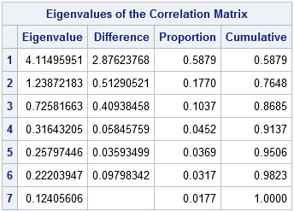
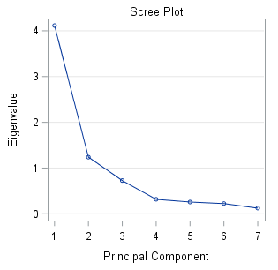
Basic Idea
Besarnya kandungan informasi pada PC diukur oleh nilai eigenvalue.
Nilai PC yang digunakan adalah yang memiliki eigenvalue>1.

Slide 11
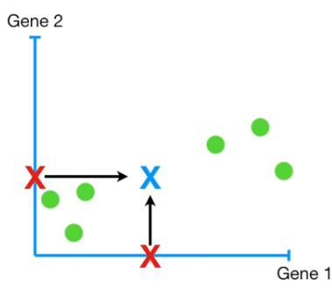
Step by Step: The Data
Imagine that we have 2 variables here, Gene 1 and Gene 2, then Calculate the mean by X
Alert: there will be so many mathematical terminology when we try to talk about PCA. I’ll try to make this quick to elaborate it in a nutshell

Slide 12
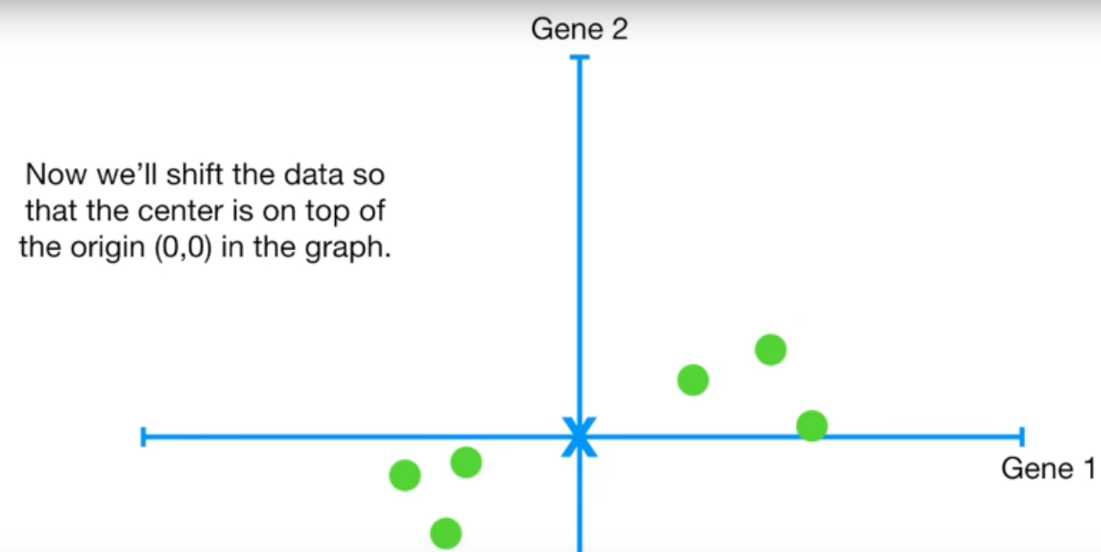
Step by Step: Data Projection
Set the mean in position (0,0) by shift the data

Slide 13
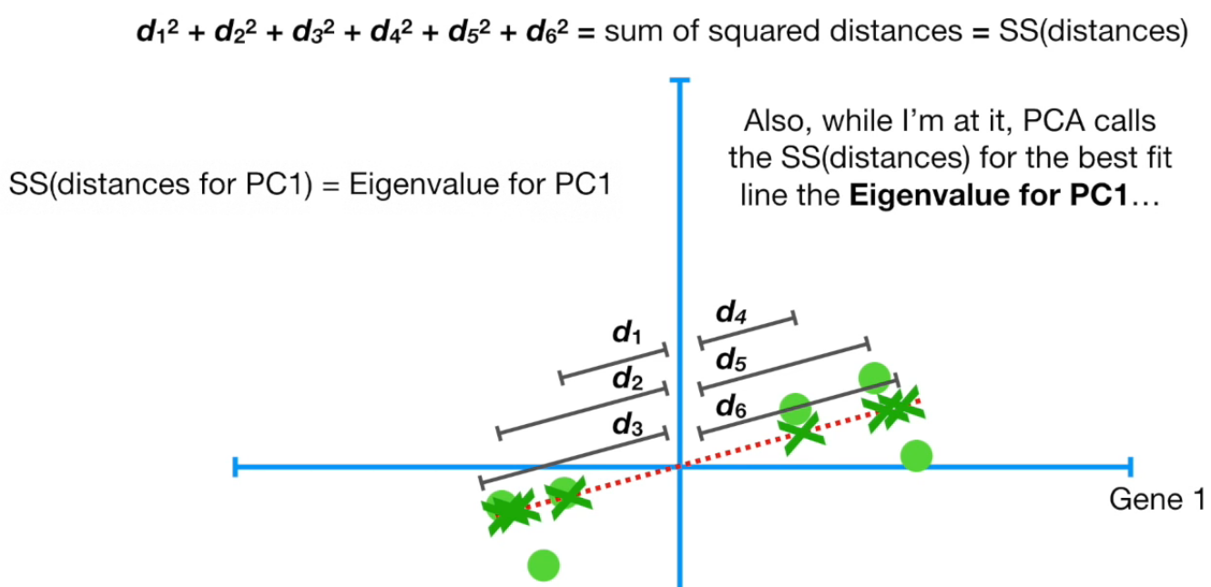
Step by Step: Calculate Sum of Square (Eigenvalue)
Try to fit a line by finding largest sum of square between data point and (0,0). that is PC1

Slide 14
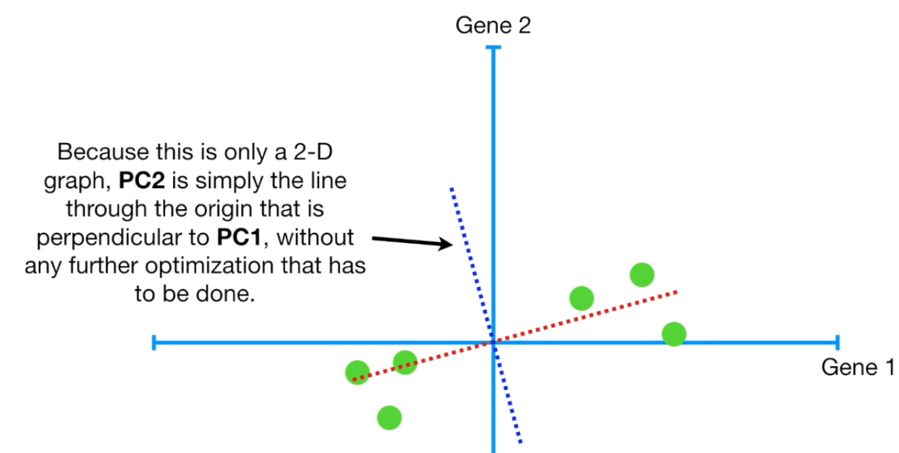
Step by Step: Find the PC2
Find the PC2 that is perpendicular to PC1

Slide 15
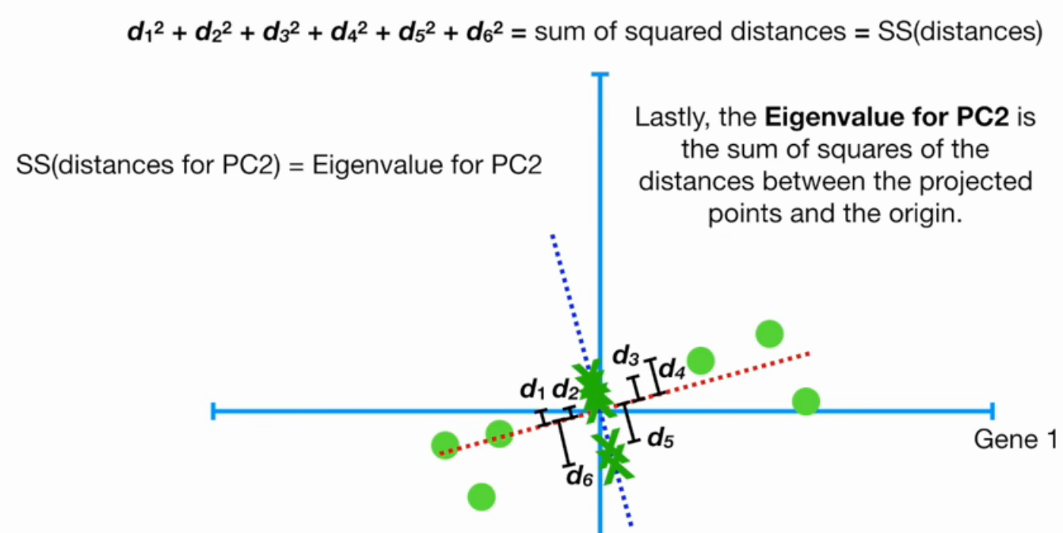
Step by Step: Calculate Eigenvalue
Calculate Sum of Square (Eigenvalue) for PC2

Slide 16
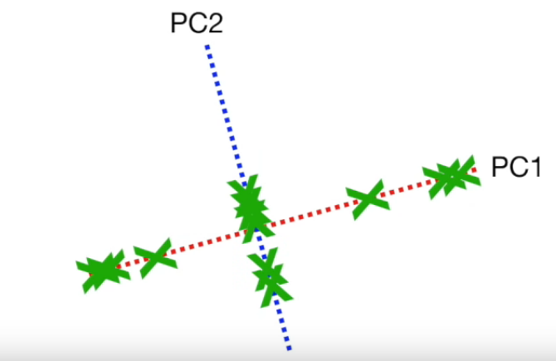
Step by Step: Result

Slide 17
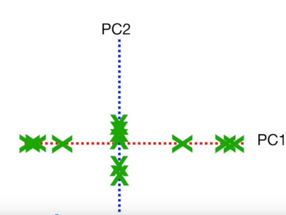
Step by Step: Result
Rotate it so PC1 need to be in horizontal position

Slide 18
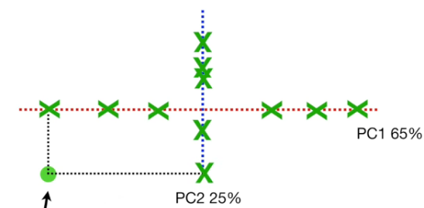
After Rotation
Where our initial data point? It represent by PC1 and PC2 now (the plot is different to get a better representation)

Slide 19
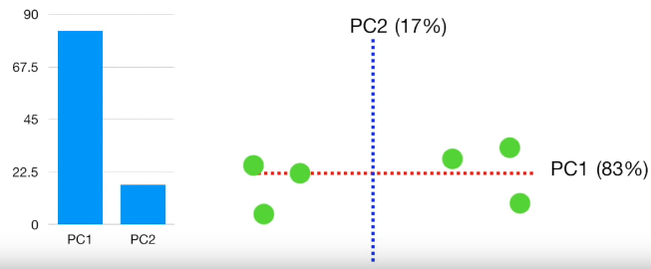
Step by Step: Calculate the Variation of PC1 and PC2
The bar plot in the left side shows the percentage of proportion(eigenvalue) between PC1 and PC2. To calculate it by using
proportion_PC1=(eigenvalue_in_PC1) / (eigenvalue_in_PC1+eigenvalue_in_PC2)
proportion_PC2=(eigenvalue_in_PC2) / (eigenvalue_in_PC1+eigenvalue_in_PC2)

Slide 20
Good Visualization to understand PCA
https://setosa.io/ev/principal-component-analysis/

Slide 21
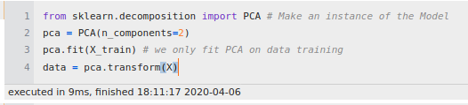
Implementation in sklearn

Slide 22
PCA Applications
Handles clustering with lots of variables
Handles Multicolinearity in Linear Regression and Logistic Regression

Slide 23
Hands On

Slide 24
Thank You

